Slide 1

CIT83104: ADVANCED WEB DESIGN AND DEVELOPMENT
By:
Mr. MANIRARORA Jean Marie Vianney
Course Code: CIT83104 & Name: ADVANCED WEB DESIGN AND DEVELOPMENT
1

Slide 2
CLASS INSTRUCTIONS
Please keep your phones aside during class sessions.
100% attendance is required for all classes.
Students are expected to practice effective time management.
Participation in all academic activities is mandatory, including:
Quizzes
In-class activities
Individual assignments
Group assignments
Presentations
Note: Failure to attend or participate in these activities may affect your overall performance.

Slide 3
MODULE OVERVIEW
Module Code: CIT83104
Title: Advanced Web Design and Development
Credits: 15
Year: 3rd Year
Prerequisite: Introduction to Web Design and Development
Total Study Hours: 150 (Lectures, Labs, Assignments, Self-study, etc.)

Slide 4
MODULE AIMS
Prepare students for professional web development
Blend theoretical knowledge with practical implementation
Focus on interactive, database-backed, and maintainable web applications

Slide 5
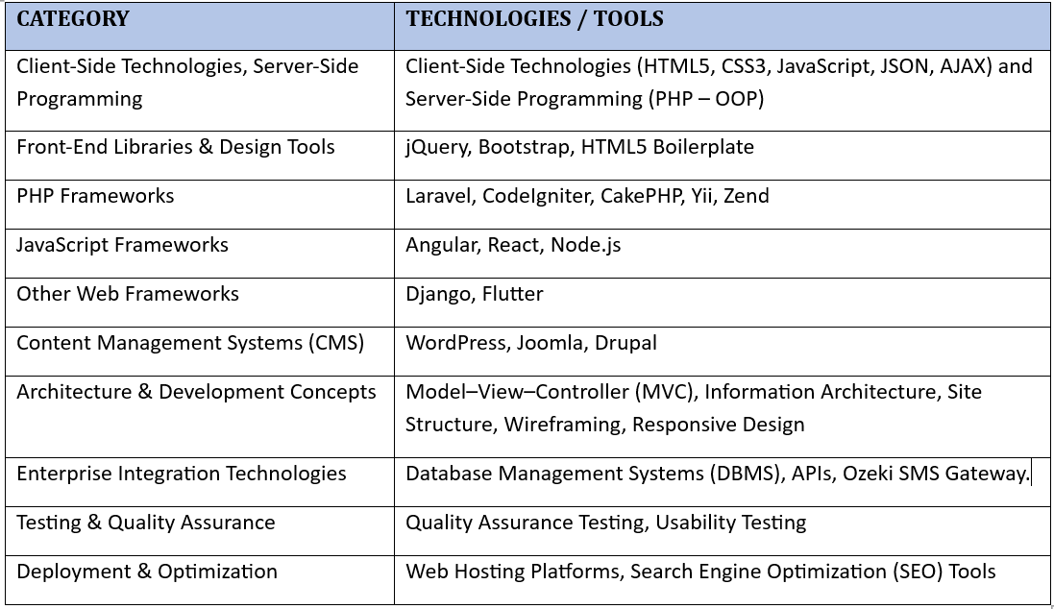
KEY TECHNOLOGIES & TOOLS

Slide 6
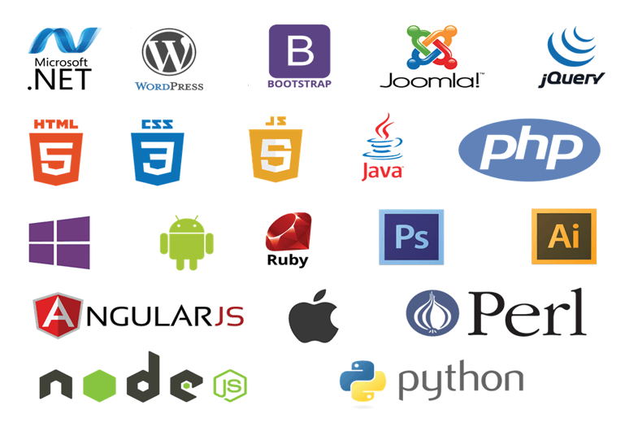

Slide 7
MODULE CONTENTS
HTML, CSS, JavaScript, layout techniques, and other industry-standard practices.
Scripting technologies to create dynamic and interactive websites.
Back-end interactivity with front-end to build web applications
Professional quality portfolio of web design work.
build Dynamic websites utilizing the most current versions of industry-standard applications and tools

Slide 8
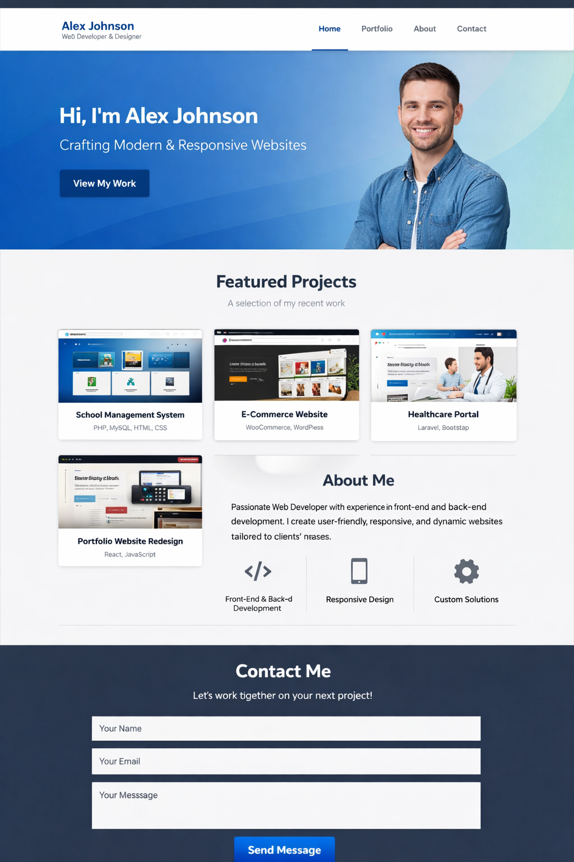
CHAP 4: Professional quality portfolio of web design work.

Slide 9
The above image is an example of a web design portfolio layout — it shows how a professional portfolio site might look with a header, hero section, featured projects, about me, and contact form.
You can use this kind of structure to present your own work clearly and professionally. It highlights:
A clean header with navigation (Home, Portfolio, About, Contact).
A hero section introducing yourself with a tagline and call‑to‑action button.
A Featured Projects grid (e.g., School Management System, E‑Commerce Website, Healthcare Portal, Portfolio Redesign).
An About Me section with skills icons.
A Contact Me section with a simple form.
This layout balances visual appeal and functionality, making it easy for visitors to understand your skills and reach out.

Slide 10
What is WordPress?
WordPress is a Content Management System (CMS) used to build and manage websites.
It is open‑source and widely used for blogs, portfolios, e‑commerce, and business sites.
It allows you to design, publish, and manage content without deep coding knowledge.
Works with themes (design) and plugins (extra features).
Comes in two versions:
WordPress.org → Self‑hosted, full control, requires your own hosting.
WordPress.com → Hosted service, easier setup but limited customization.

Slide 11
Key Features
Themes → Pre‑designed templates to change the look of your site.
Plugins → Add extra functionality (SEO, forms, galleries, security).
User‑friendly → No coding required, but supports custom HTML, CSS, PHP.
Responsive Design → Most themes adapt to mobile and desktop automatically.
Community Support → Large global community, tutorials, and resources.
Advantages
Easy to use for beginners.
Highly customizable with themes and plugins.
Supports multimedia (images, video, audio).
SEO‑friendly (with plugins like Yoast SEO).
Scalable — from small blogs to large business sites.

Slide 12
Common Uses
Personal blogs.
Professional portfolios.
Business websites.
E‑commerce stores (with WooCommerce plugin).
Educational or institutional websites.

Slide 13
Themes (for layout & design)
Astra → Lightweight, responsive, and perfect for portfolios.
Neve → Clean and modern, easy to customize.
OceanWP → Feature‑rich with portfolio demos.
Hestia → Stylish one‑page theme, good for student projects.
These themes give you the structure and look of the site.
Plugins (for functionality)
Elementor (free) → Drag‑and‑drop page builder to design sections like hero, projects, and about.
WPForms Lite → To create the contact form (“Get In Touch”).
Envira Gallery Lite → For project image galleries.
Yoast SEO (optional) → For search optimization when you move online.
These plugins add the features you need beyond the theme.

Slide 14
Tools for Offline Setup
XAMPP or LocalWP → To run WordPress locally on your computer.
phpMyAdmin → To create the database for WordPress.
WordPress core files → Downloaded once from wordpress.org..
Workflow
Install WordPress offline (via XAMPP or LocalWP).
Upload and activate your chosen theme (e.g., Astra).
Install Elementor to design the layout visually.
Add WPForms for the contact form.
Use Envira Gallery for project showcases.
Customize colors, fonts, and images to match your design.

Slide 15
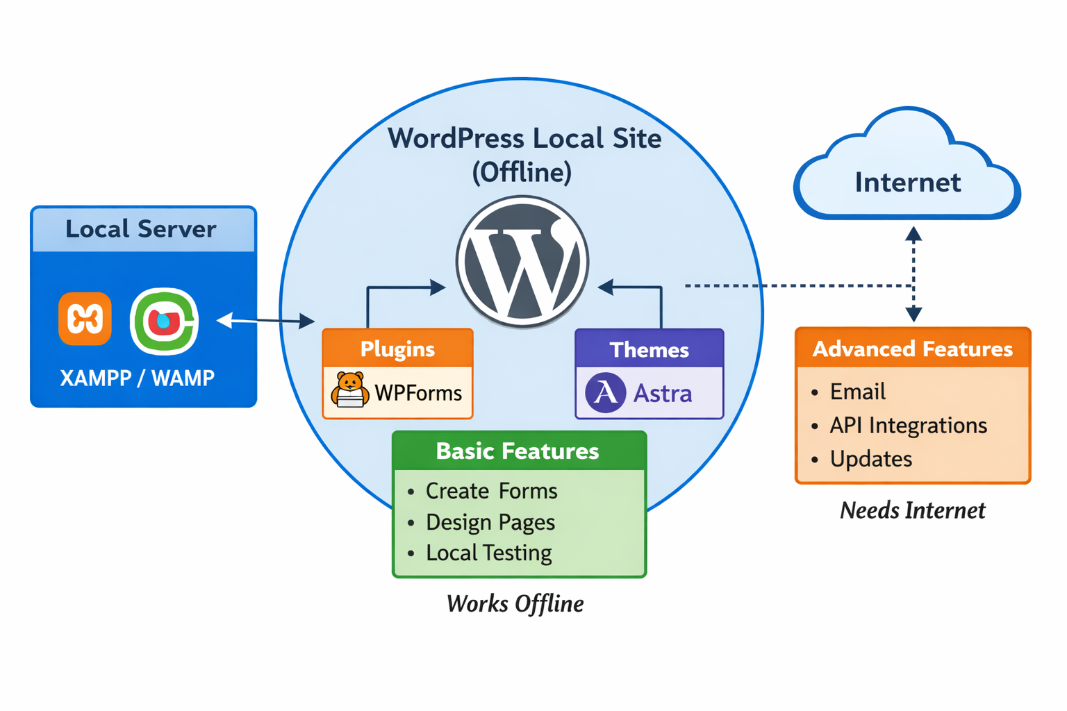

Slide 16
let’s walk through a step‑by‑step process to build a simple portfolio site using WordPress.org locally. I’ll keep it clear and practical, and I’ll also give you a visual aid to help picture the workflow.
1. Install Local Server (XAMPP or Local by Flywheel)
Download and install XAMPP (or another local server like WAMP, MAMP, or LocalWP).
Start Apache and MySQL services — these simulate a web server on your computer.
2. Download WordPress.org
Go to wordpress.org and download the latest WordPress package.
Extract the files into your local server’s web directory:
For XAMPP: C:\xampp\htdocs\mysite
3. Create a Database
Open http://localhost/phpmyadmin in your browser.
Create a new database (e.g., portfolio_db).

Slide 17
4. Run WordPress Installation
Visit http://localhost/mysite in your browser.
Follow the WordPress setup wizard:
Enter database name (portfolio_db), username (root), and leave password blank (default for XAMPP).
Choose site title, admin username, and password.
5. Choose a Theme
Log into WordPress dashboard (http://localhost/mysite/wp-admin).
Go to Appearance → Themes → Add New.
Search for a portfolio theme (e.g., Astra, OceanWP, or Neve).
Install and activate the theme.

Slide 18
6. Add Pages
Create pages like:
Home
About Me
Projects
Contact
Use Pages → Add New in the dashboard.
7. Add Content
Add text, images, and project details to each page.
Use the Block Editor (Gutenberg) or install a page builder plugin (like Elementor) for drag‑and‑drop design.
8. Customize Menu
Go to Appearance → Menus.
Add your pages to the main navigation menu.
9. Test Locally
Visit http://localhost/mysite to see your portfolio.
Adjust design and content until satisfied.
10. (Optional) Prepare for Deployment
When ready, you can move your local WordPress site to online hosting using plugins like All‑in‑One WP Migration.

Slide 19
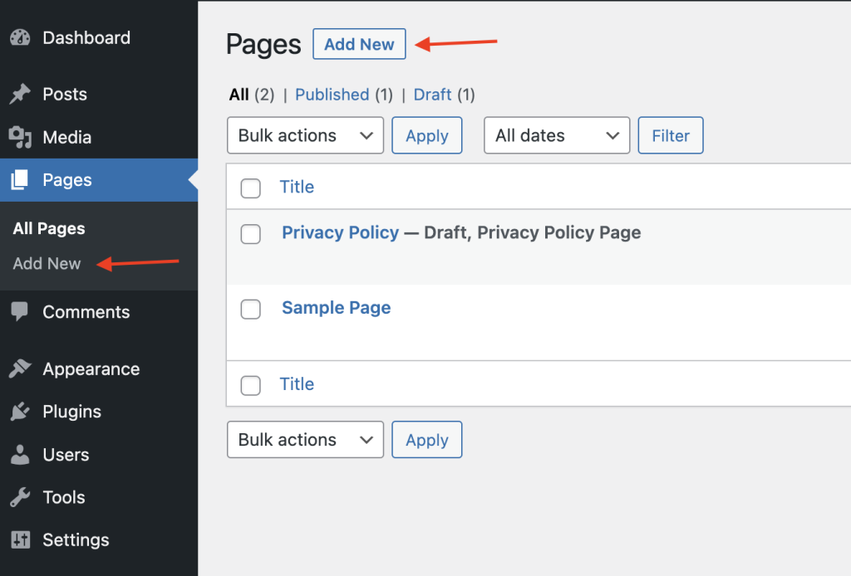
1. To create a new Page:

Slide 20
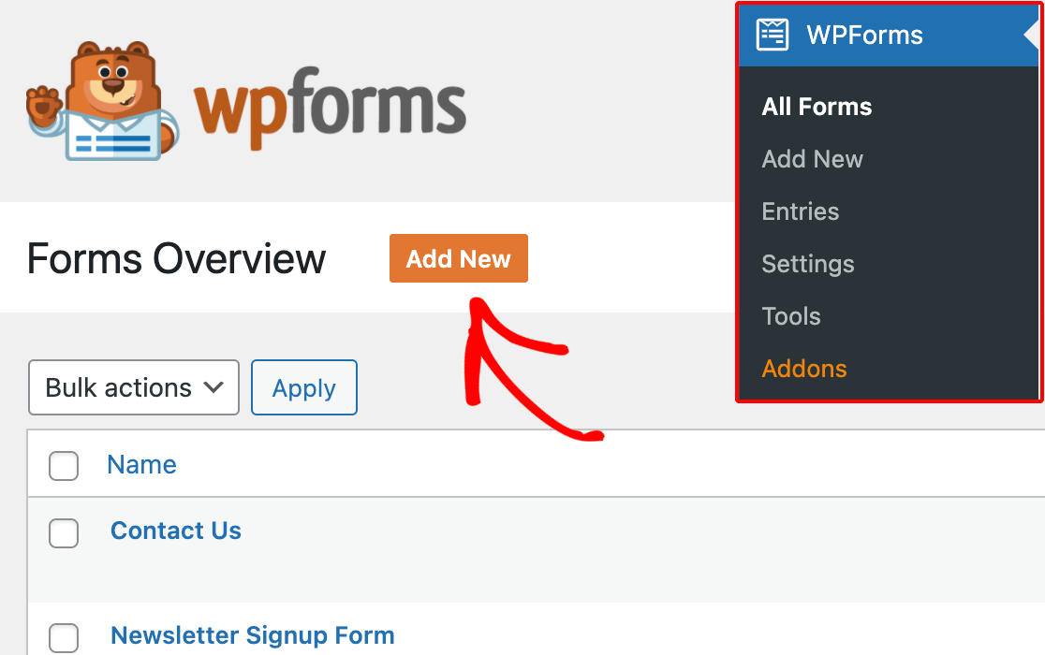
Adding a New Form

Slide 21
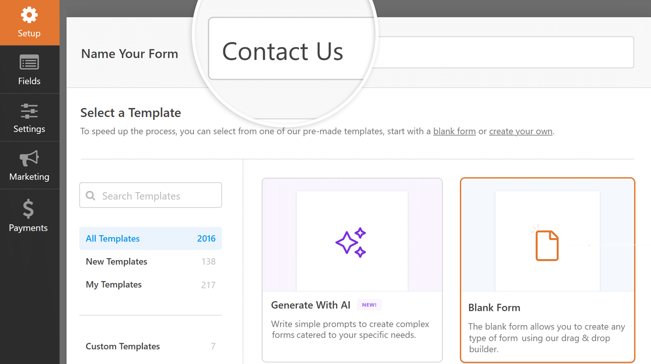
In the Setup page of the form builder, you can enter a name for your form (such as “Contact Us”) in the Name Your Form input field.

Slide 22
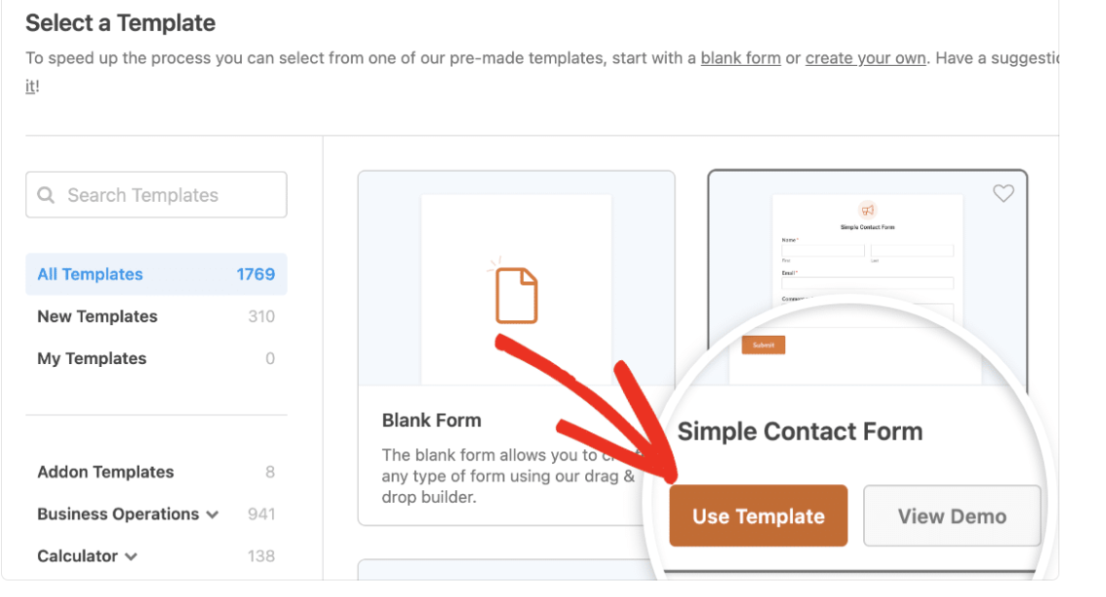

Slide 23
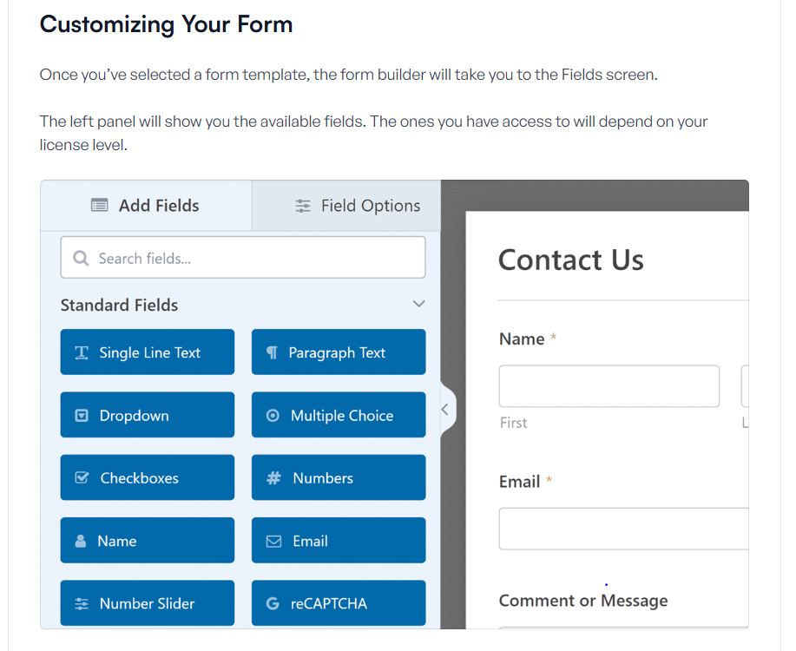

Slide 24
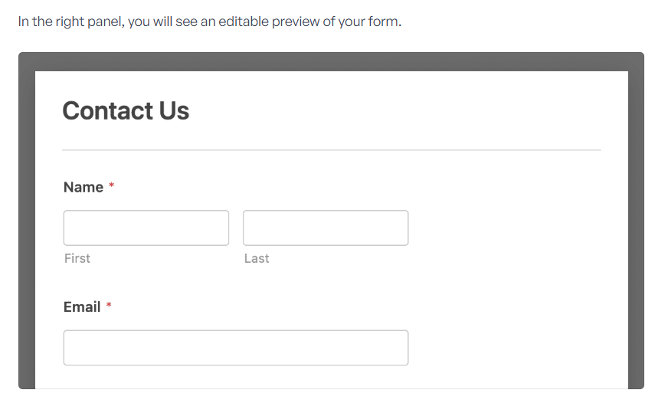

Slide 25
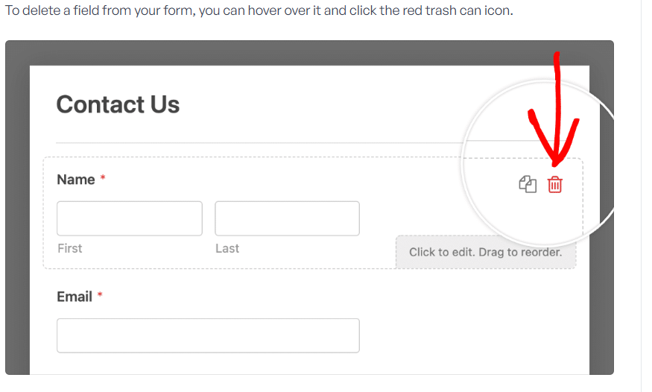

Slide 26
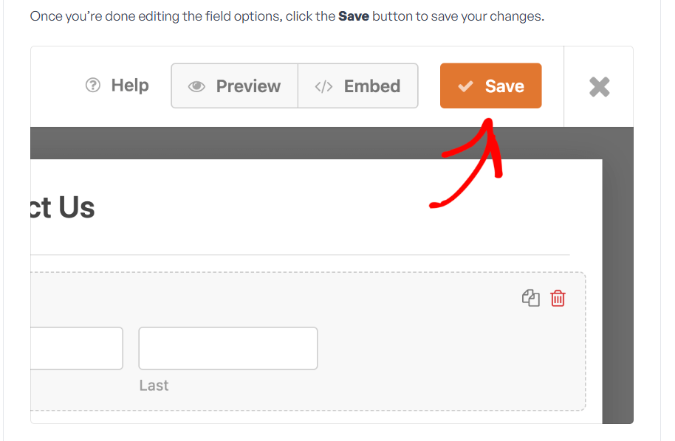

Slide 27
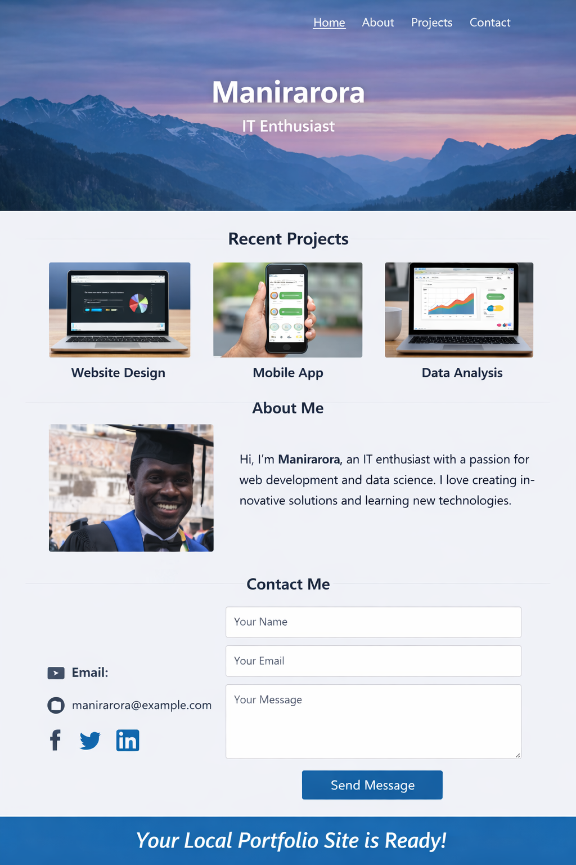
1. Task: Design a simple portfolio like this one using your own photo.

Slide 28
END OF CHAP 4

